Slide 1
Attention algorithms
2021. 08. 12.
BCML

Slide 2
index
Seq2seq, Attention structure
Word to Word translation
Attention mechansim

Slide 3
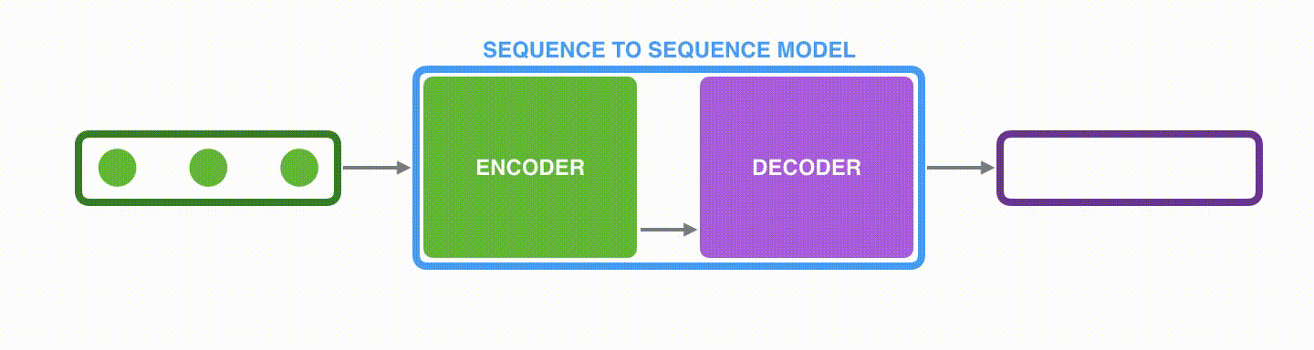
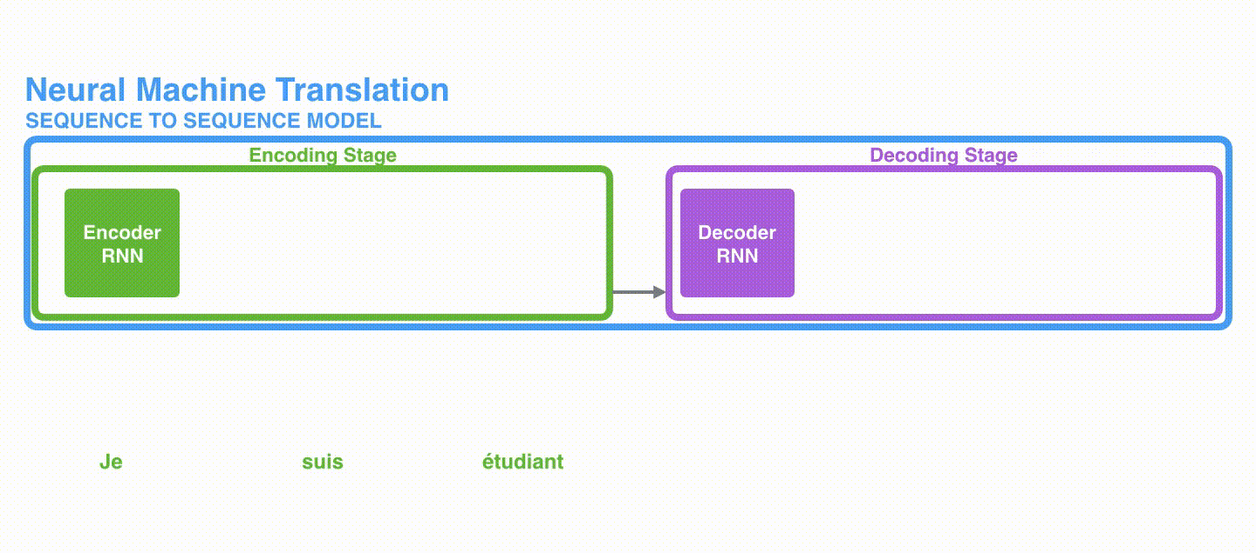
seq2seq
seq2Seq (Seq to Sequence) is a model that receives an item's sequence and presents another sequence.
The problem with Seq2seq is that the Encoder's output is a fixed length vector.

Slide 4
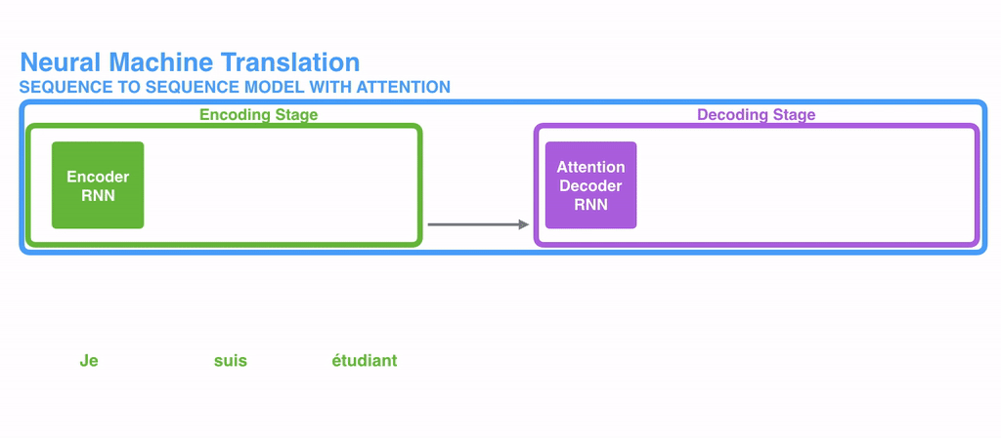
Attention

Slide 5
English to Korean
I love you = nan nul saranghey
난 널 사랑해

Slide 6
Word to Word translation?
Input |  | Prediction
I |  |  | nan(난)
love |  |  | saranghey(사랑해)
you |  |  | nul(널)
I love you |  |  | Na saranghey nul (난 사랑해 널)

Slide 7
Second issue of word to word translation is output always have same word count with input, while it should not
How are you ? = jal jiney ?
3 words 잘 지내
2 words

Slide 8
Decoder then outputs a translation from the encoder vector (context vector)
Encoder | Decoder
<start>
Fixed size
Context vector
I
love
you
Nan
nul
saranghey

Slide 9
Context vector may not have all necessary info if input with long sentence
Fixed size
1 | 2 | 3 | 4 | … | 98 | 99
1 | 2 | 3 | ... | 19 | 20
Context vector​

Slide 10
Rather than using fixed context vector, we can use encoder's each state with current state to generate dynamic context vector
<start>
Decoder
 |  |  |  | …
1
2
3
4
98
99
1 | 2 | 3 | 4 | … | 98 | 99
1 | 2 | 3 | ... | 74 | 75
<end>

Slide 11
1. Encode info into sequence of vectors not in a single context vector 2. Choses a subset these vectors adaptively while decoding the translation
<start>
Decoder
 |  |  |  | …
1
2
3
4
98
99
1 | 2 | 3 | 4 | … | 98 | 99
1 | 2 | 3 | ... | 74 | 75
<end>

Slide 12
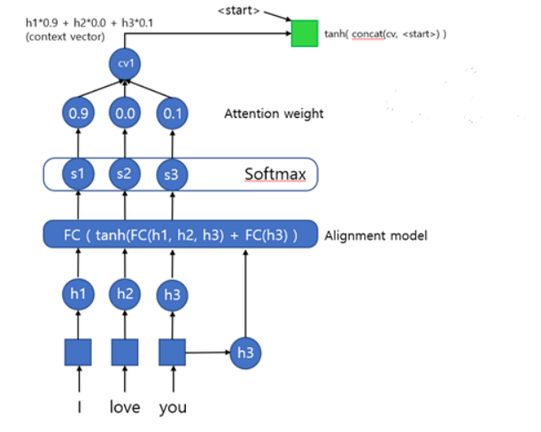

Slide 13
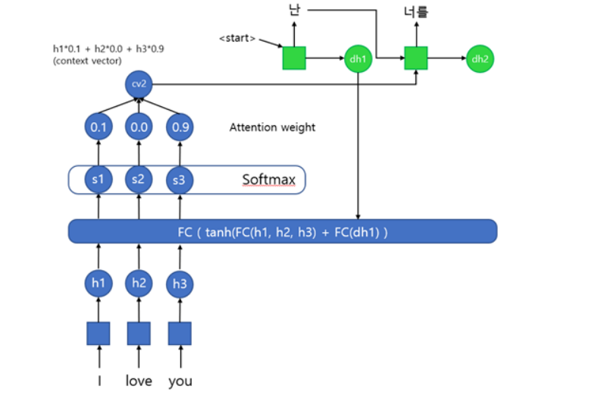

Slide 14
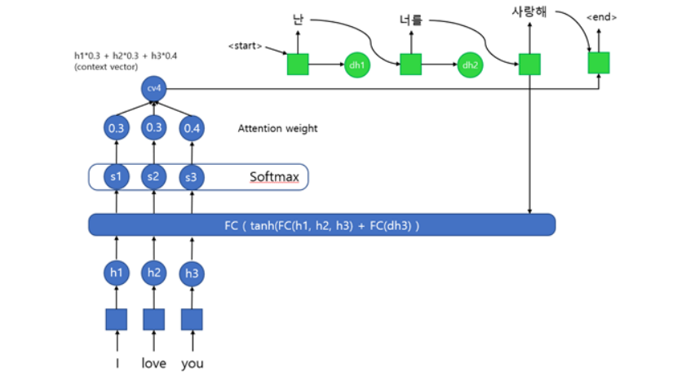

Slide 15
Thank you!
Q&A

